Slide 1
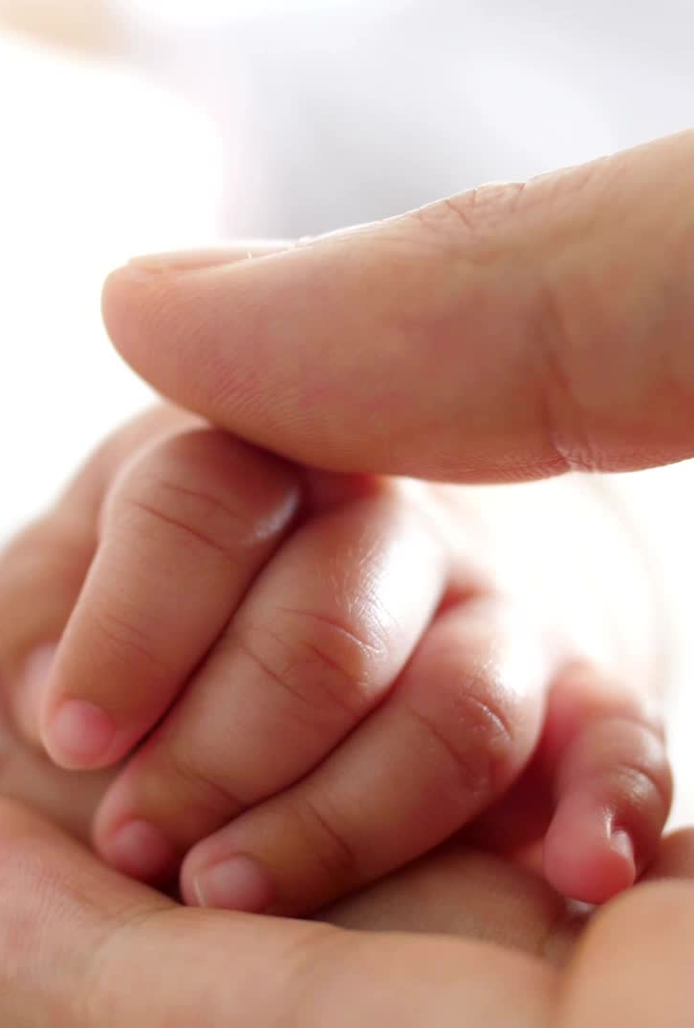
Care of normal newborn

Slide 2
Healthy Infant
A healthy infant born at term between 38-42 weeks should have average birth weight (more then 2500gms), cries immediately following birth, establishes independent rhythmic respiration & quickly adapts to the changed environment.

Slide 3
Initial Assessment

Slide 4
Assessment of Newborn Baby
Initial Assessment
Purposes
To assess the need for resuscitation
To ascertain the gestational age
To detect the presence of any congenital anomalies or any disorder which may affect the well being of the baby.

Slide 5
Assessment of Newborn Baby
Initial Assessment
Done at the place of birth by trained birth attendant immediately after the delivery of neonate.
In postnatal period- Done for atleast 3 times

Slide 6
1st Assessment- within 24 hours or next day and at the time of discharge.
2nd Assessment- Within 2 weeks of age
3rd Assessment- Within 4-6 weeks of age of baby

Slide 7
Physiological Characteristics of Healthy Newborn
Respiratory Rate- 30-60 breaths/ min
Heart Rate- 120-160 beats/ min
Temperature- 36.5-37.5 degree Celsius
Blood Pressure-
Systolic- 60-80mmHg
Diastolic- 25-40mmHg

Slide 8
Physical Characteristics of Healthy Neonate
Weight- 2.5-3.9kg (avg-2.9kgs)
Length- 48-53cms (avg- 50cms)
Head Circumference- 33-37cms (avg- 35cms)
Chest Circumference- 3cms less then head circumference

Slide 9
APGAR SCORE
CRITERIA | 0 | 1 | 2
Respiration | Absent | Slow, irregular | Good, crying
Heart rate | Absent | Slow (Below 100) | More than 100
Muscle tone | Flaccid | Some flexion of extremities | Active body movements
Reflex response | No response | Grimace | Cry
Skin color | Blue, pale | Body pink, extremities blue | Completely pink

Slide 10

TOTAL SCORE = 10
No depression: 7-10
Mild depression: 4-6
Severe depression: 0-3

Slide 11
Assessment Of Gestational Age

Slide 12
Reflexes of normal neonate

Slide 13
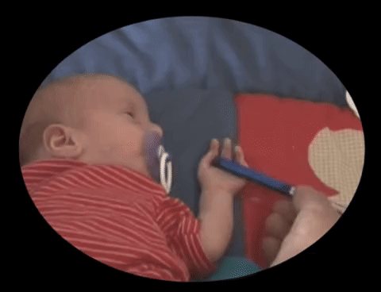
PALMAR GRASPING
REFLEX
Disappear in about 4-6 months of age

Slide 14
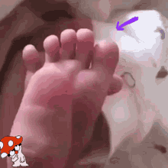
PLANTER GRASPING
REFLEX
Disappear in about 9 months to 1 year of age

Slide 15
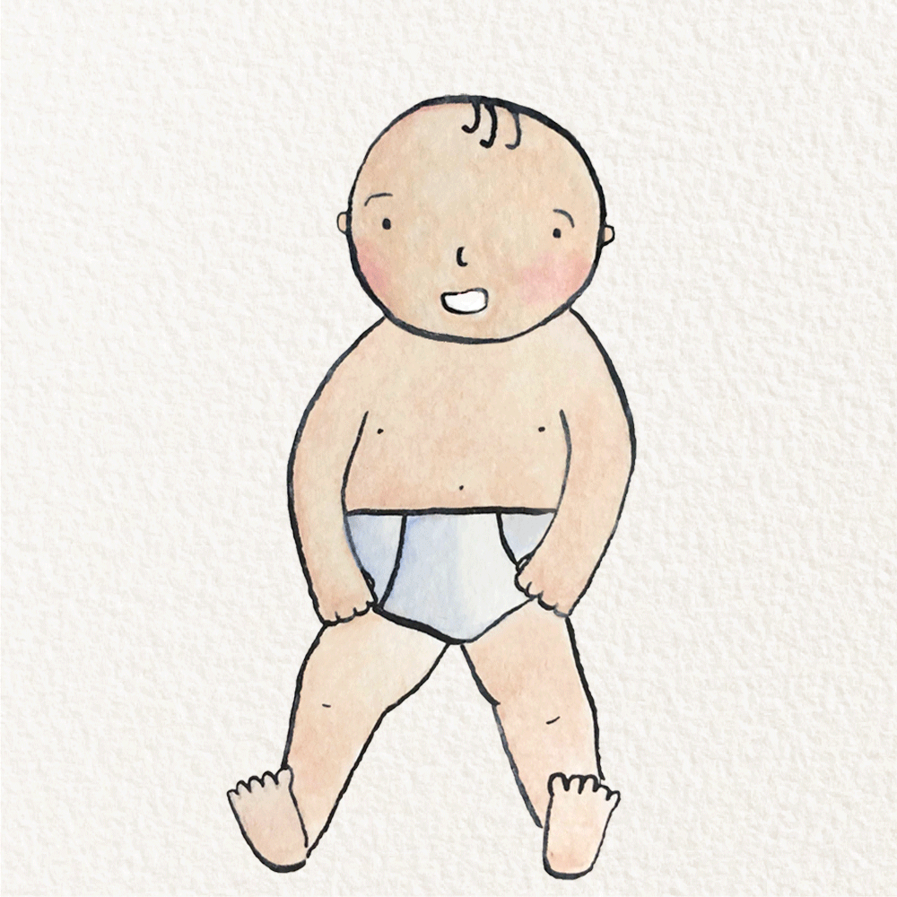
MORO REFLEX (Startle Reflex)
When the infant hear sudden loud noise or experience sudden movement the infant will extend the arms up, and the move the arms back to the body.
Disappear in about 6 months.

Slide 16
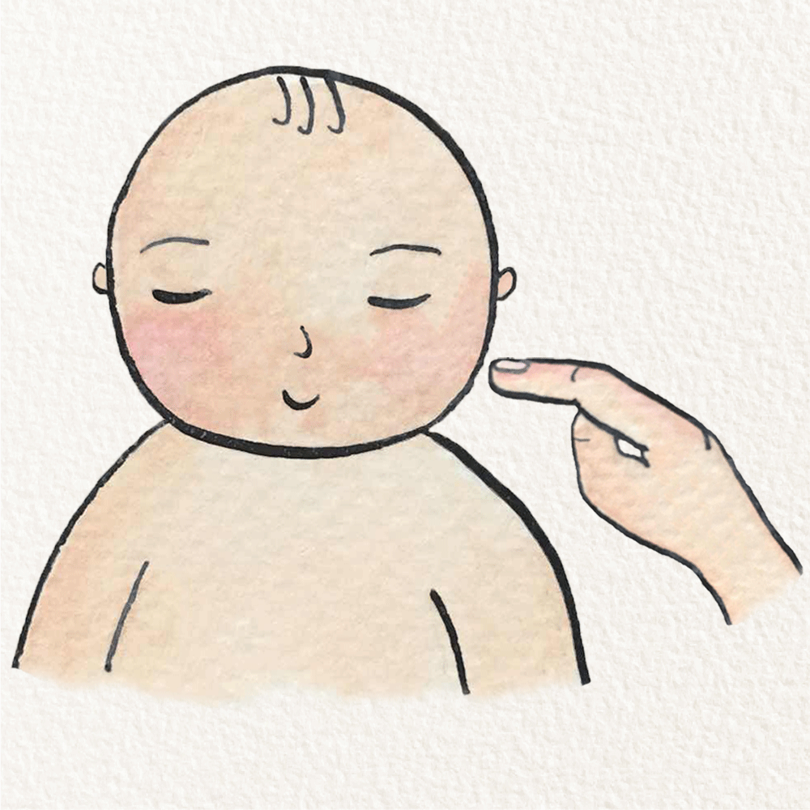
ROOTING
REFLEX
Disappears in about 4 months of age.

Slide 17

SUCKING REFLEX
Disappear in about 4 months.

Slide 18
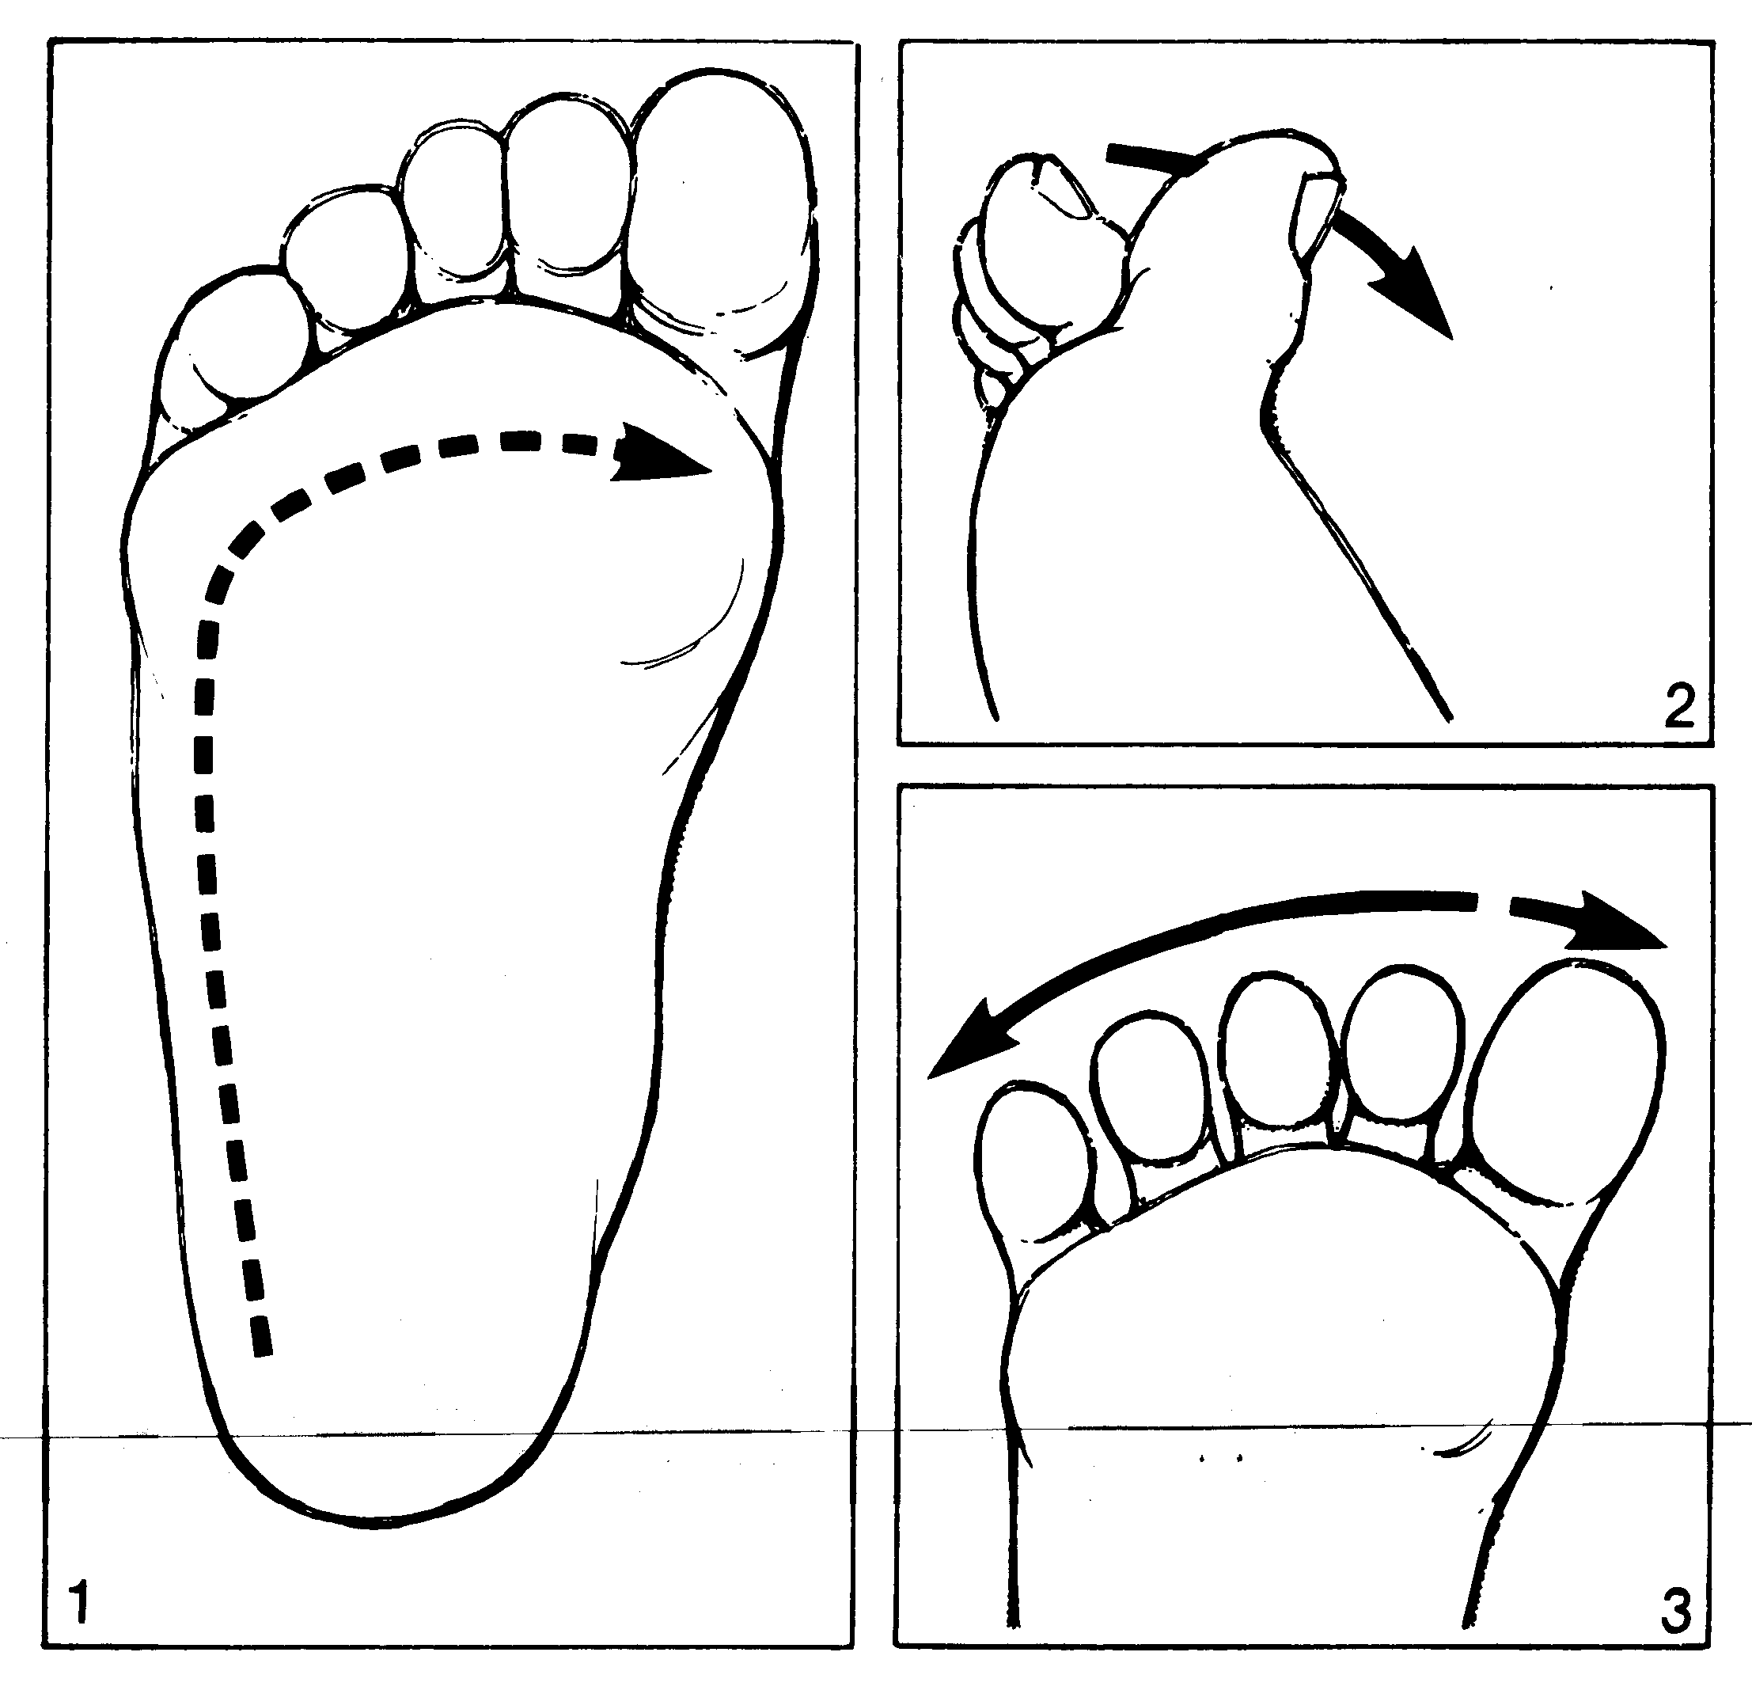
BABINISKI REFLEX
Disappear in about 1 year.

Slide 19
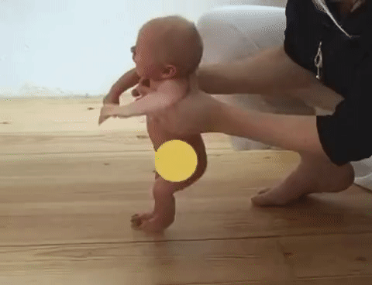
STEPPING OR DANCING REFLEX
Disappear in about 3-4 months of age.

Slide 20
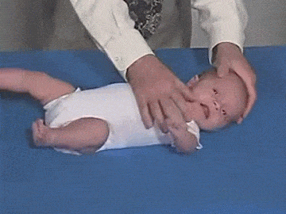
TONIC NECK REFLEX
When infant head is turned to a particular side, the leg and arm on that side will extend while the leg and arm on the opposite side will flex.
Disappear in about 4 months of age.

Slide 21
Immediate newborn care

Slide 22
Immediate Basic Care At Birth
Maintenance of temperature
Establishment of open airway & circulation
Identification of newborn
Vitamin K injection
Initiation of breastfeeding.

Slide 23
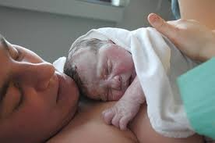
Maintenance of Temperature:
Immediately dry the infant under a radiant warmer
Skin to skin contact with the mother.
Keep neonates head covered.
Rooming in (The baby should not be separated from the mother)

Slide 24
Establishment of Open Airway
(Majority of babies cry at birth & take spontaneous Respiration)
✔ When the head is delivered birth attendant immediately suction the secretions, wipe mucus from face and mouth and nose.

Slide 25
CON….
✔ Suction the mouth and nose by using bulb syringe
✔ Keep head slightly lower than the body
✔ Position the Baby on their backs or tilted to the side, but not on their stomachs.

Slide 26
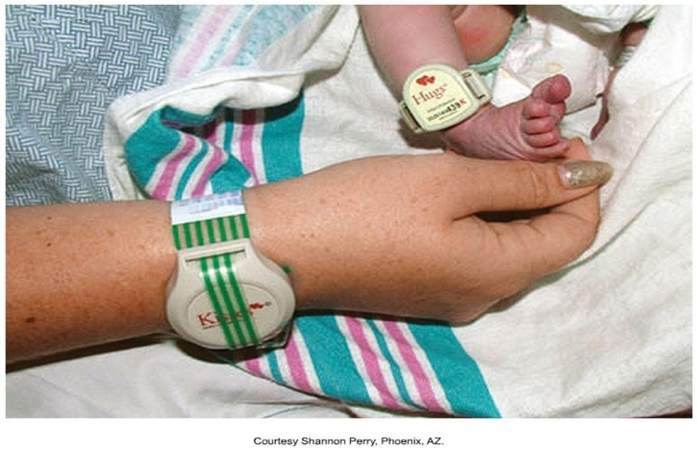
Newborn Identification
Newborn Identification Before a baby leaves the delivery area, identification bracelets with identical numbers are placed on the baby and mother. Babies often have two, on the wrist and ankle.

Slide 27
Vitamin K
Vitamin K prevent neonatal hemorrhage during first few days of life before infant is able to produce Vitamin K administration:
✔ Term infants (1mg) - IM
✔ Preterm infants (0.5mg) – IM

Slide 28
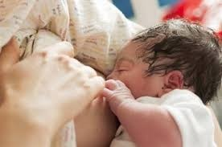
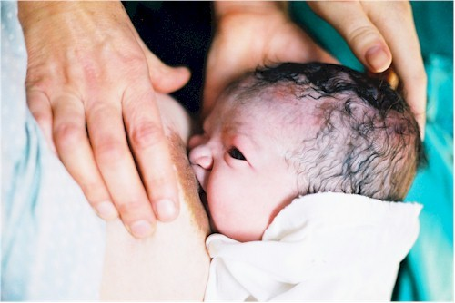
Initiation of Breastfeeding
Babies can be breast-fed as soon as the airway is cleared and they are breathing normally.

Slide 29
DAILY ROUTINE CARE OF NEONATES
The majority of complication of the normal newborn may occur during first 24 hours or within 7 days. So close observation & daily essential routine care is important for health & survival of the newborn baby.
The major goals:
Establish & maintain homeostasis
Stability of normal physiological status.

Slide 30
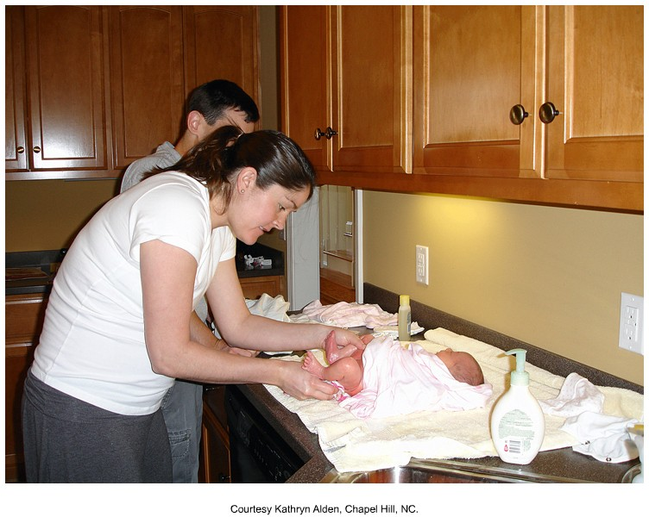
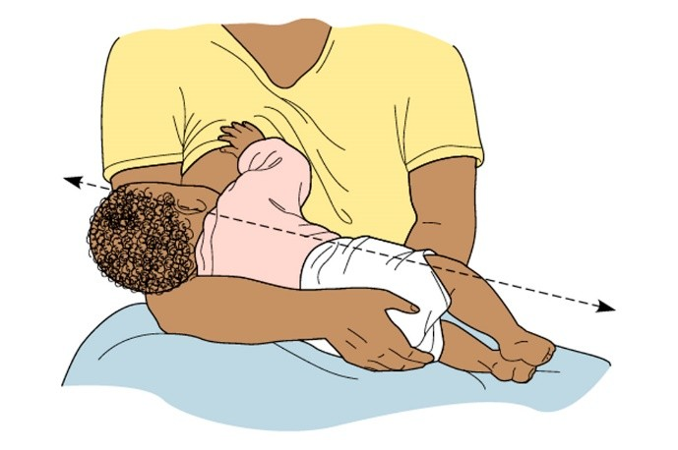
The daily routine care of the neonates are as follows:
✔ Warmth
✔ Breastfeeding
✔ Skin care & baby bath
✔ Care of umbilical cord
✔ Care of the eyes
✔ Clothing of the baby

Slide 31
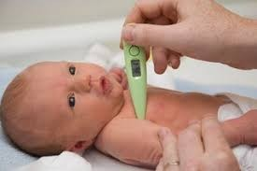
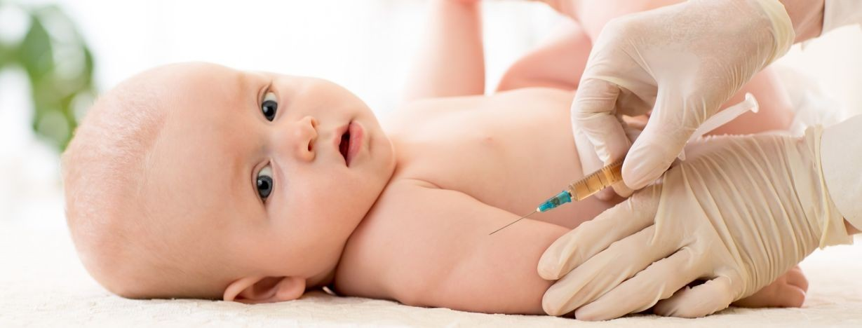
✔ General care
✔ Observation- cynosis, jaundice, output
✔ Taking anthropometric measurement
✔ Vital signs
✔ Immunization
✔ Follow up & advice

Slide 32
WARMTH
Warmth is provided by keeping the baby dry & wrapping the baby with adequate clothing in two layers, ensuring head & extremities are well covered. Baby should kept by the side of the Mother.
BREAST FEEDING
Breastfeeding The baby should be put to the mother’s breast within half an hour of birth or as soon as possible the mother has recovered from the exertion of labour.

Slide 33
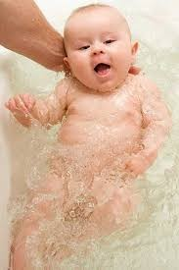

Skin Care & Baby Bath
The skin should be cleaned off blood, mucus & meconium by gentle wiping before he/she is presented to the mother. Baby bath can be given at the hospital or home by using warm water in a warm room gently & quickly.
First Bath: Once a baby's temperature has stabilized, the First bath can be given.

Slide 34
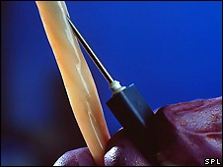
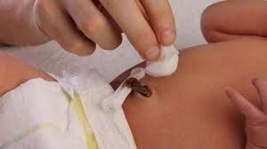
CORD BLOOD COLLECTION
Make sure cord blood is collected for analysis and sent to laboratory for checking of: Rh Blood type, Hematocrit & possible cord blood gases.

Slide 35
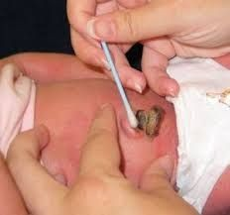
CARE OF THE UMBILICAL CORD
✔ Keep the cord stump clean and dry.
✔ Topical application of antiseptics is usually not necessary unless the baby is living in a highly contaminated area.

Slide 36
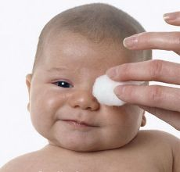
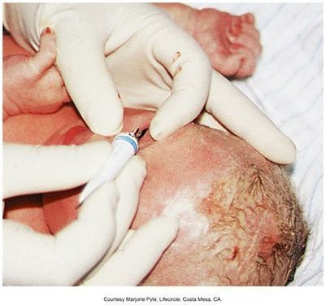
CARE OF THE EYES
Eyes should be clean at birth & once in every day using sterile cotton swabs soaked in sterile water or normal saline. Separate swabs for each eye.

Slide 37
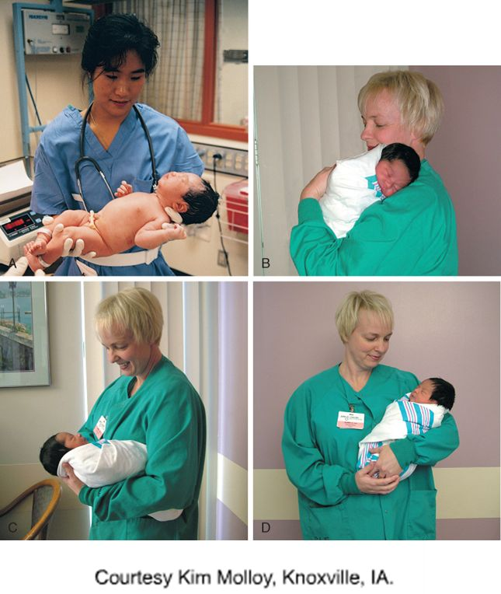
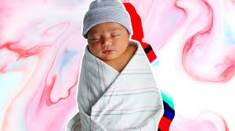
Clothing of the baby:
✔ The baby should be dressed with loose, soft & cotton cloths. The frock should be open on the front or back for easy wearing.
✔ Large button, synthetic frock and plastic or nylon napkin should be avoided.

Slide 38
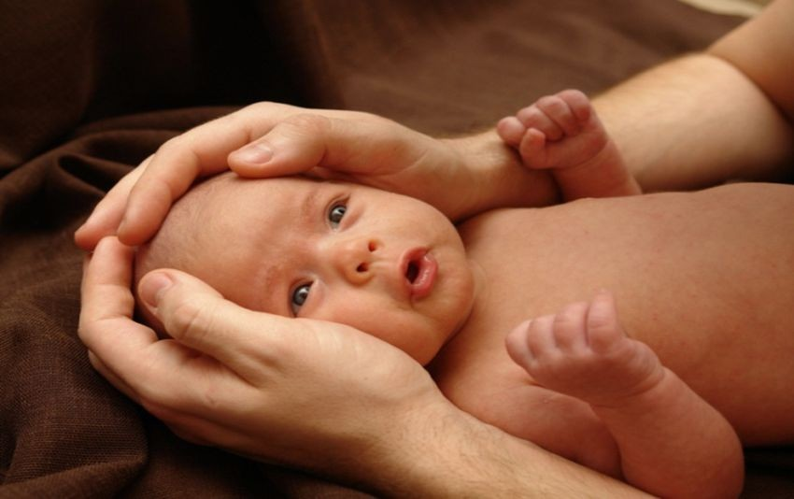
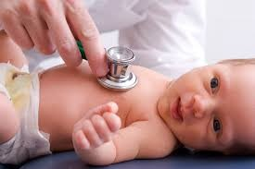
General care:
✔ Rooming –in
✔ gentle approach
✔ Aseptic technique
✔ sensory stimulation
✔ tender& loving care
Observation:
▶ The baby should be kept in continuous observation twice daily for detection of any abnormalities.

Slide 39
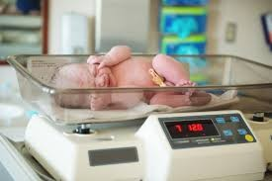
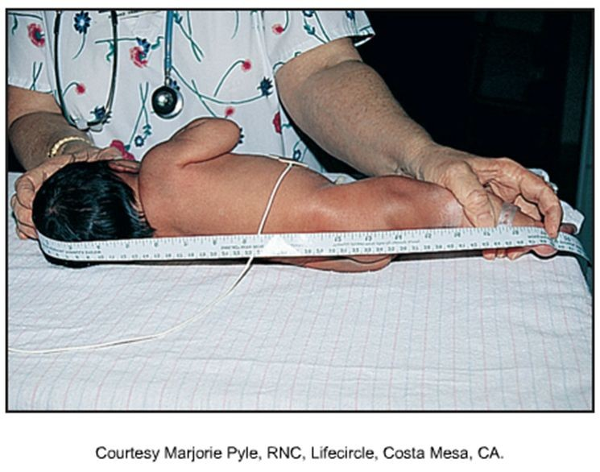
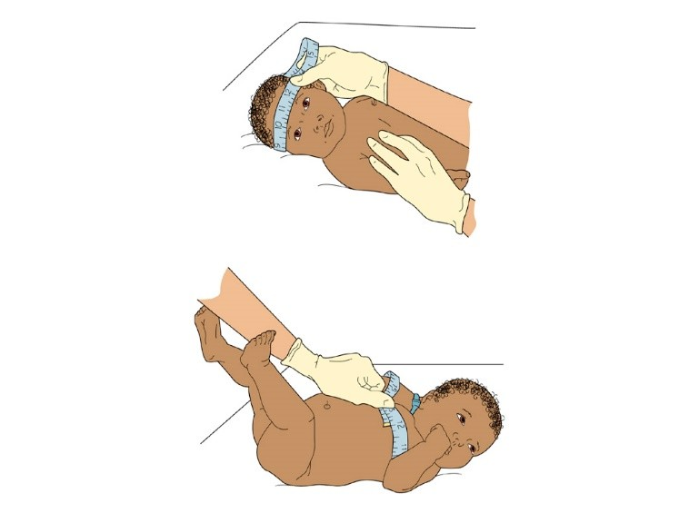
Anthropometric Measurement
✔ Measure weight
✔ Length
✔ Head circumference
✔ Chest circumference

Slide 40
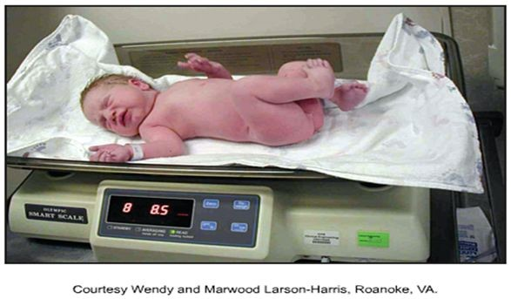
WEIGHT:
✔ The average daily wt gain for healthy term babies is about 30gm/day in the first month of life
✔ It is about 20gm/day in second month
✔ 10gm per day afterwards during the first year of life.
LENGTH: (from top of head to the heel with the leg fully extended)
✔ Average range: 18-22 inches (46-56 cm)

Slide 41
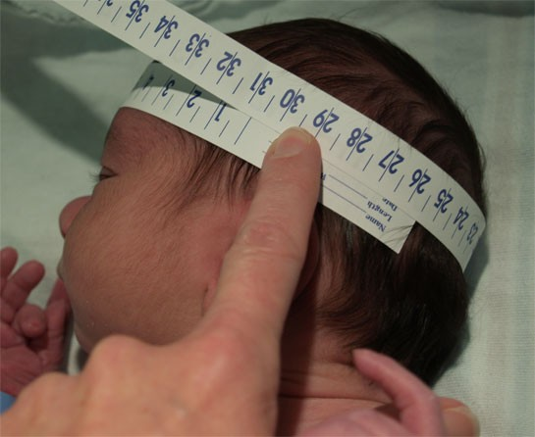
Head circumference:
Head circumference (repeat after molding and caput succedaneum are resolved). Average range: 33 to 35 cm (13-14 inches) Normally, 2-3 cm larger than chest circumference Place tape measure above eyebrows and stretch around fullest part of occipital at posterior fontanel.

Slide 42
Chest circumference (at the nipple line):
Average range: 30-33 cm (12-13 inches) Normally, 2-3 cm smaller than head circumference Stretch tape measure around scapulae and over nipple line.
Immunization:
Newborn should be immunized with BCG vaccine & ‘0’ dose of ‘OPV’. Hepatitis ‘B’ vaccine can be administered at birth as first dose & other two doses in one month & 6 months of age.

Slide 43

Follow up & Advice:
Each infant should be followed up, at least once every month for first 3 months & subsequently 3 month interval till one year of age.

Slide 44
Nursing Diagnoses:
▶ Ineffective airway clearance related to nasal and oral secretions from delivery.
▶ Ineffective thermoregulation related to environment and immature ability for adaptation.
▶ Risk for injury related to immature defenses of the newborn.
▶ Risk for infection related to immature immune system

Slide 45


