Slide 1
GENETICS
Ms. Shireen Singh
Assistant Professor

Slide 2
Introduction
During mid 19th Century, Mendel observed that certain features pass from parents to their children/offspring.​
A child usually looks like their parents and is due to inheritance of certain characteristics from parents to children .​
This transmission of characteristics from parents to children is known as heredity.​
The basic unit of heredity is gene, which consist of portion of DNA molecules.​

Slide 3
Genetics
Genetics is the study which deals with the science of genes, heredity and its variations in living organism.​
Mendel is the father of Genetics​
The term Genetics was coined by William Bateson​

Slide 4
Terminologies
Chromosomes​
Gene​
Alleles ​
  Dominant ​
  Recessive​

Slide 5
Chromosomes
Chromosomes are present in nucleus and made up of genetic material (DNA).
DNA is a thread like structure.
When DNA is present in highly compact form (tightly packed or coiled) around the histone protein is called chromosomes.

Slide 6
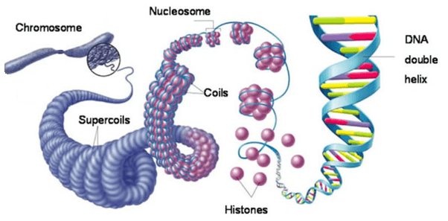

Slide 7
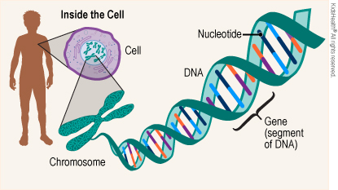
Gene
DNA have information for the synthesis of protein.
Gene are segments of DNA.
Gene are functional unit of DNA. Have nucelotide sequence have information regarding synthesis of one protein.

Slide 8
Allele
An allele is one of two, or more, forms of a given gene variant.​
Each allele determines a single inherited characteristics in an individual.​

Slide 9
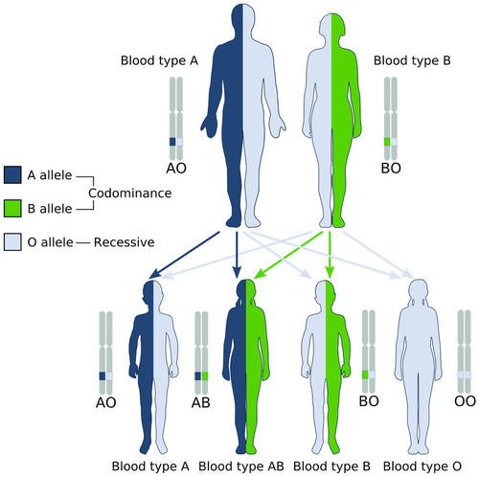

Slide 10
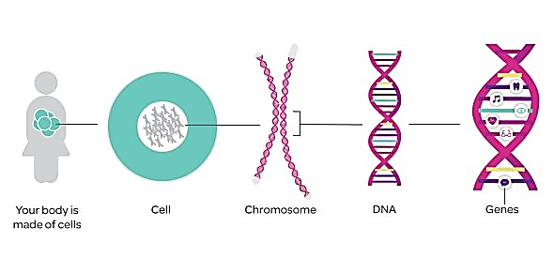

Slide 11
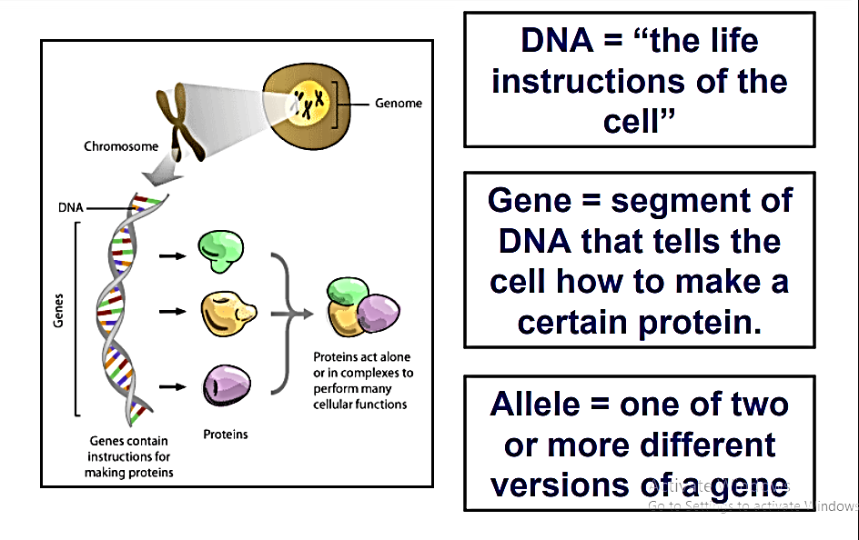

Slide 12
Practical Applications Of Genetic In Nursing​

Slide 13
Role of Nurse in Genetics
Nurses came across individual or families affected by the genetic diseases.
Nurses are a vital link between patient and health care services.
Nurses should have basic knowledge of genetics.​
The important role of nurses in genetic include - ​

Slide 14
Genetics Counselling and Interviewing
Interviewing patients or individuals with suspected genetic disorders​
Taking a detailed clinical history along with relevant family history (over three generations) from patients or parents of child with genetic disorder.​
Refer those with genetic disorder to the concerned doctor.​

Slide 15
Planning, Screening or Gene Based Testing Programs​
Provide health education related to genetics and genetic testing.​
Drawing and interpreting a pedigree chart.​
Ability to recognize the possibility of a genetic disorder based on the pedigree chart.​
Assessment of a genetic risk especially in conjugation with genetic testing options.​

Slide 16
Monitoring ​
Follow up of positive newborn screening test.​
Monitoring individuals with genetic disorders​
Working with families under stress due to a genetic disorder.​

Slide 17
Care ​
Developing an individualized plan of care and services of affected patient.​
Participating in public education about genetics.​
Maintain the privacy and confidentiality of the patients genetic information. ​

Slide 18
Educational Role ​
Genetic Aspect ​
When a genetic condition is identified, it leads to stress and shock in the individuals and his family.​
The nurses have a major role in counseling, reducing their fears, getting the consent for genetic testing and arranging the tests and offering post test advice. ​
About Transmission of genetic condition within families​
If an individual is identified to have a genetic condition, nurses should educate the family members, who are likely to affected and advice counseling and screening for them.​​

Slide 19
Educational Role ​
Educate how genetics and environmental factors influence health and disease.​
Nurses should be able to identify the Mendelian patterns of inheritance of genetic conditions in families in the form of a pedigree (family tree)​

Slide 20
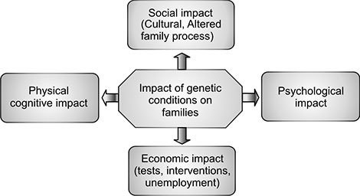
Impact of Genetic Conditions on Families​​

Slide 21
Impact of Genetic Conditions on Families​
Guilt – Parents with genetic disorder tend to feel guilty, when they come to know that they might have passed on a condition to a child.​
Depression – When an individual comes to know that he/she has a genetic condition and the decision not to have a children or decision to terminate a pregnancy, may result in depression or loss of peace of mind. ​

Slide 22
Gene

Slide 23
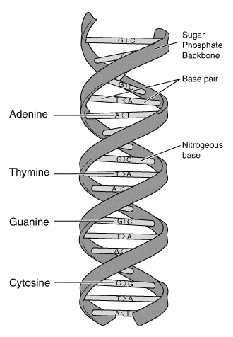
Structure of Gene
DNA: Genes are composed of DNA (deoxyribonucleic acid), a long, double-stranded molecule.
Nucleotides: DNA consists of repeating units called nucleotides, which include a sugar (deoxyribose), a phosphate group, and one of four nitrogenous bases: adenine (A), thymine (T), cytosine (C), or guanine (G).
Double Helix: DNA strands twist together to form a double helix structure, with complementary base pairs (A-T and C-G) holding the strands together.

Slide 24
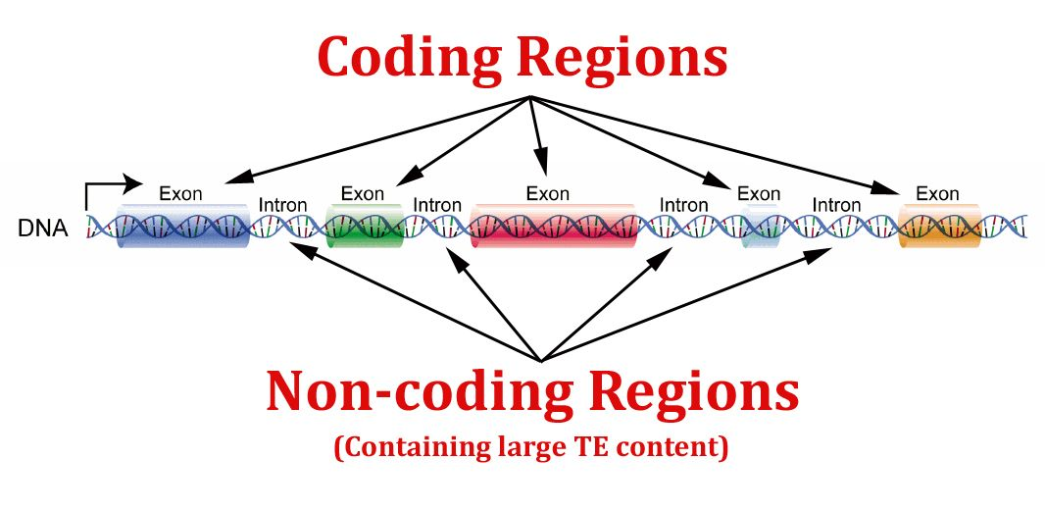
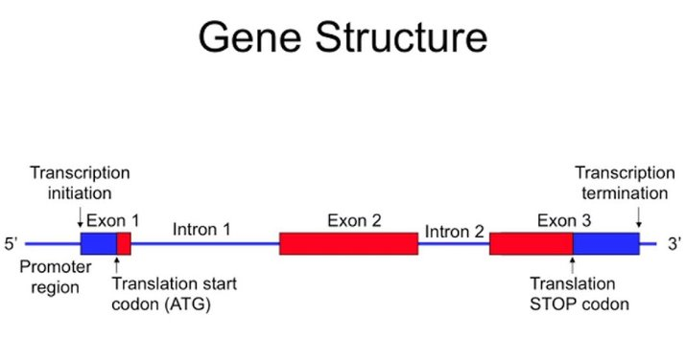
Structure of Gene
Coding Regions: Genes have coding regions, or exons, which contain the instructions for synthesizing proteins or functional RNA molecules.
Non-Coding Regions: Genes also have non-coding regions, or introns, which do not code for proteins but may play regulatory roles.
Promoter Regions: Near the beginning of a gene, there are promoter regions that help regulate the initiation of gene transcription.

Slide 25
Characteristics of Gene
Genetic Information: Genes carry the genetic information necessary for the formation and functioning of an organism.
Inheritance: Genes are passed from one generation to the next through reproduction.
Variability: Genes can exist in different variants or alleles, leading to genetic diversity within a population.
Mutability: Genes can undergo mutations, which are changes in their DNA sequence, leading to genetic variation.

Slide 26
Characteristics of Gene
Determination of Traits: Genes determine specific traits and characteristics in an organism, such as eye color, height, and susceptibility to certain diseases.
Functional Units: Genes serve as functional units of heredity, controlling various biochemical processes in cells.
Regulation: Genes can be turned on or off through regulatory mechanisms, allowing for precise control of gene expression.
Interaction: Genes often interact with one another and with environmental factors to influence an individual's phenotype (observable traits).

Slide 27
Sex Determination

Slide 28
Sex determination
Sex determination is the process of sex differentiation by which whether a particular individual will develop into male or female sex. ​
The sex chromosomes are responsible for determination of separate sexes.​
Sex expression is governed by chromosomes and genes.​
In unisexual animals, chromosomes are of two types, autosomes and allosomes. ​
Autosomes – Chromosomes which do not differ in morphology and number in male and female. ​
Allosomes or sex chromosomes – Chromosomes which differ in morphology and number in male and female and contain genes that determine sex.​

Slide 29
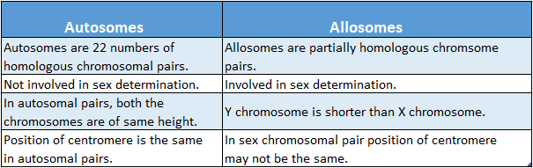

Slide 30
Sex determination
Human body cells have 46 chromosomes arranged in 23 pairs. ​
There are 22 pairs of autosomes and one pair of sex chromosomes (allosomes). ​
Female have a perfect pair of sex chromosome XX.​
Male have mismatches pair of sex chromosome XY. ​
Both male and female contain equal amount of chromosome 23 pair ​
Out of 23 pair: 22 pairs are autosomes 1 pair is sex chromosome.​

Slide 31
Chromosomal Aberration

Slide 32
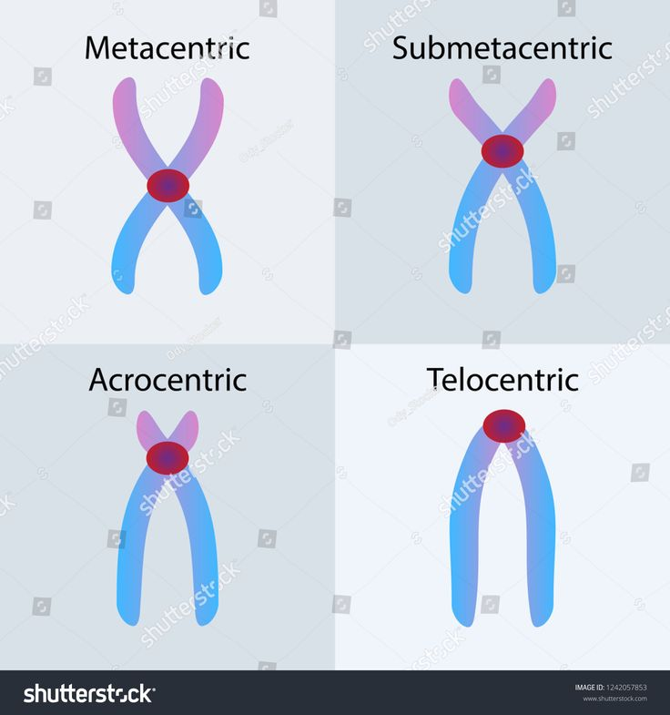
Chromosomal Aberrations
Change/abnormality in factor of Chromosome Wheater it is in the form of number or in the form of structure.
Types of chromosome:
Metacentric
Submetacentric
Acrocentric
Telocentric

Slide 33
Chromosomal Aberrations
Numerical Aberrations: Is defined as change in number of chromosomes.
Aneuploidy: is defined as there is increase/ decrease in one or two chromosome.
Polyploidy: Is defined as increase/ decrease in set of chromosome.

Slide 34
Chromosomal Aberrations
Numerical Aberrations:
Aneuploidy:
Monosomy: One chromosome is missing. (2n-1), Ex: Turner’s syndrome.
Trisomy: One extra chromosome is present. (2n+1), Ex: Down syndrome
Tetrasomy: Two extra chromosomes are present. (2n+2)

Slide 35
Chromosomal Aberrations
Numerical Aberrations:
Polyploidy:
Triploidy: Increase in one haploid set of chromosomes. (2n+23)= 2 X 23 +23= 69. (3n)
Tetraploidy: Increase in one diploid set of chromosomes. (2n+46)= 2X23 + 46= 92 (4n)

Slide 36
Chromosomal Aberrations
Structural Aberrations: Changes/ abnormality in the structure of chromosomes.
Translocation
Deletion
Insertion
Duplication
Inversion

Slide 37
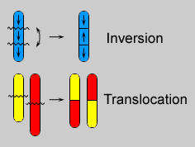
Chromosomal Aberrations
Structural Aberrations:
Translocation: Change in location of arms of chromosome.

Slide 38
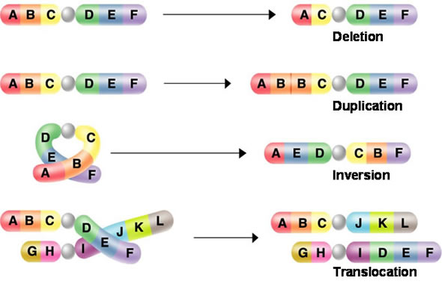
Chromosomal Aberrations
Structural Aberrations:
Deletion: Deleting of one segment of chromosome from one end of chromosome.

Slide 39
Chromosomal Aberrations
Structural Aberrations:
Insertion: Addition of one segment of chromosome at one end.

Slide 40
Chromosomal Aberrations
Structural Aberrations:
Duplication: Copy of one segment of chromosome.

Slide 41
Chromosomal Aberrations
Structural Aberrations:
Inversion: A segment of a chromosome is rotated 180°

Slide 42
Multiple Allots & Blood Group

Slide 43
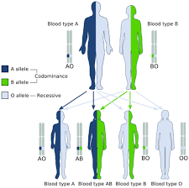
Multiple Allots
More than two alternative forms of a gene present on the same locus.
Chromosome contains only one of the group.

Slide 44
Blood Group (ABO System)
Blood Group (Phenotype) | Genotype | Red Cell Antigen | Antibodies in serum
A | AO, AA | A | Anti B
B | BO, BB | B | Anti A
AB | AB | AB | None
0 | OO | None | Anti A Anti B

Slide 45
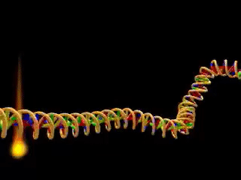
Mutation

Slide 46
Definition
Change in chemical structure of gene or chromosomes or change in nucleotide sequence of DNA.

Slide 47
Types of Mutation
Gene Mutation (Change in structure of gene)
Chromosomal Mutation (change in structure, size and number of chromosomes)

Slide 48
Gene Mutation

Slide 49
Types of Gene Mutation
1. Point Mutation
2. Frame Shift Mutation

Slide 50
1. Point Mutation
Change in specific point of gene.
Replacement of one nucleotide by another.
Occur by two methods.
Transition- Purine, pyrimidine replaced by another Purine, pyrimidine.
Tranvesion- Purine replaced by pyrimidine vice versa.

Slide 51
Types of Point Mutation
 | Normal | Silent Mutation | Nonsense Mutation | Missense Mutation
DNA | AGT | AGA | ATT | GGT
mRNA | UCA | UCU | UAA | CCA
Protein | Serine | Serine | Termination Code (stop protein synthesis) | Proline (abnormal protein synthesis)

Slide 52
2. Frameshift Mutation
One or more base pair inserted or deleted result in altered reading frame of the mRNA.

Slide 53
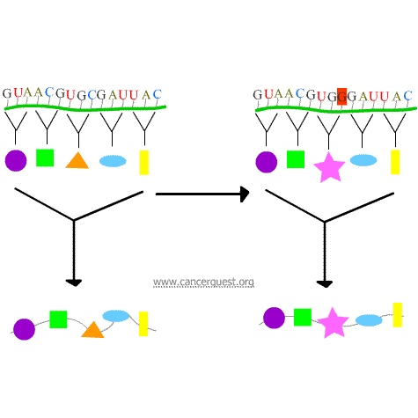

Slide 54
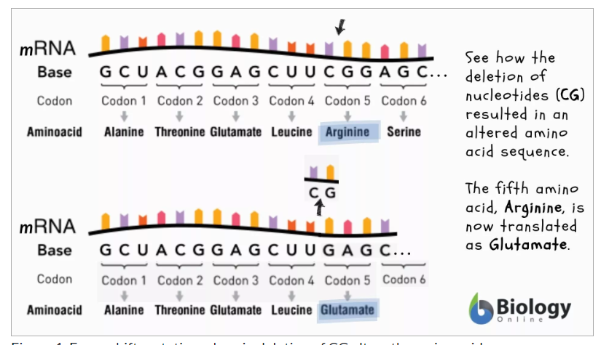

Slide 55


