Slide 1
FETAL CIRCULATION

Slide 2
INTRODUCTION
The circulatory system of the fetus is known as fetal circulation. It is present only in the fetus. It contains some special structures that help the developing fetus to exchange material with the mother.
The special structures are the following:
Ductus venosus
Foramen ovale
Ductus arteriosus

Slide 3
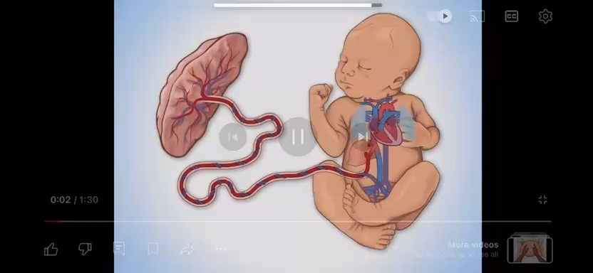

Slide 4
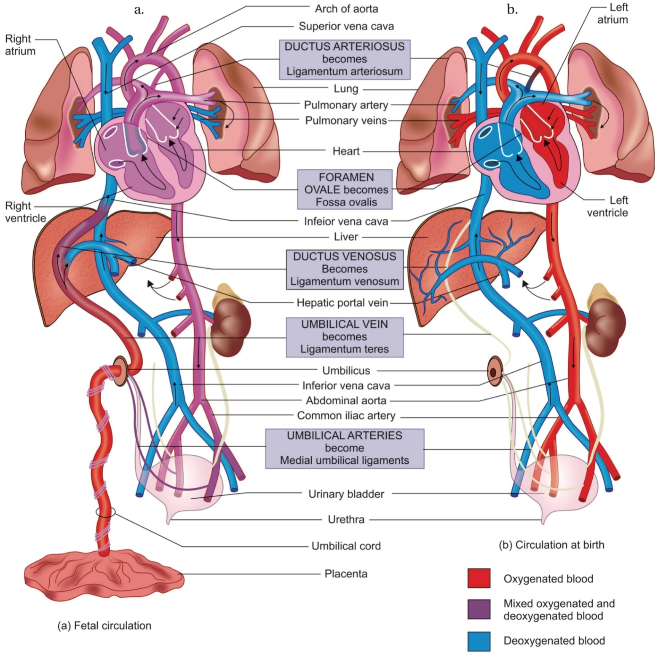
Fetal circulation and changes at birth
(a) fetal circulation
(b) post-natal circulation

Slide 5
FETAL CIRCULATION
Fetal circulation is different from the post-natal circulation because the various organs such as lungs, kidneys and gastrointestinal organs are not functional until birth.
Thus the developing fetus gets the nutrition from the mother through maternal blood and excretes the waste into it.

Slide 6
The placenta is the structure through which the exchange between the mother and the fetus takes place. It is connected to the fetus by a umbilical cord. This umbilical cord contains 1 umbilical vein and 2 umbilical arteries. They branch into capillaries and merge with the placenta.

Slide 7
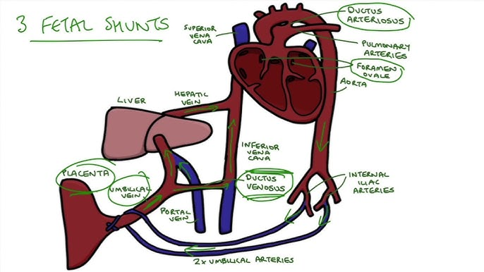

Slide 8
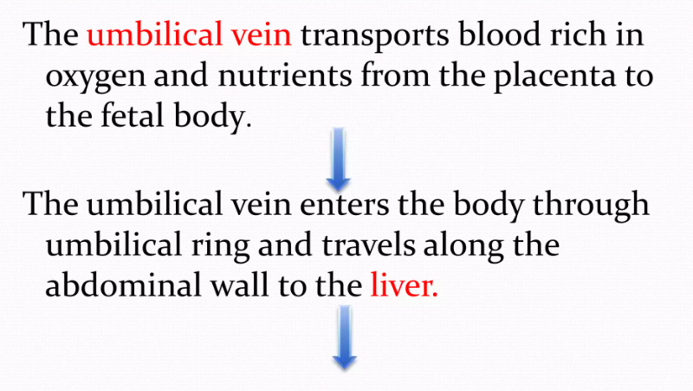

Slide 9
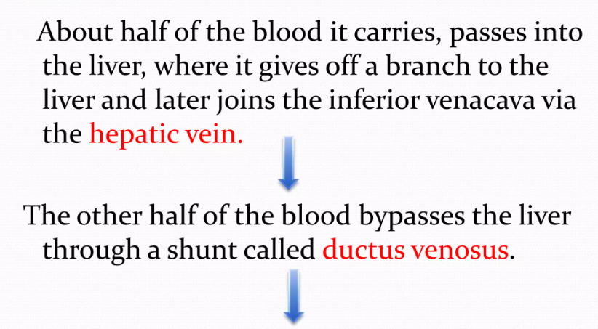

Slide 10
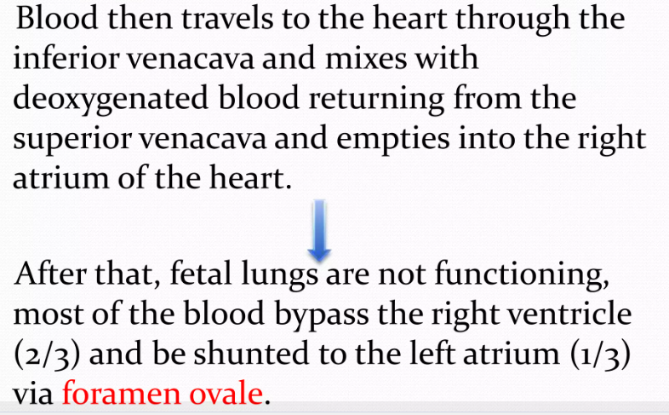

Slide 11
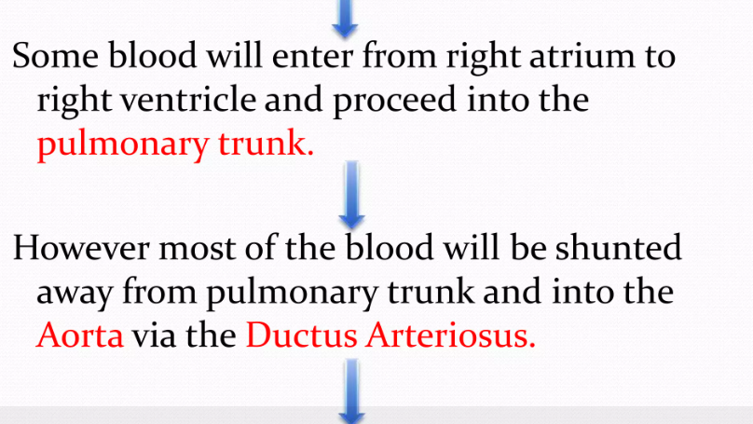

Slide 12
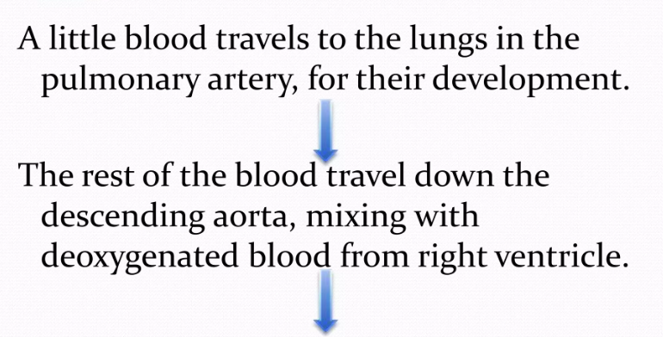

Slide 13
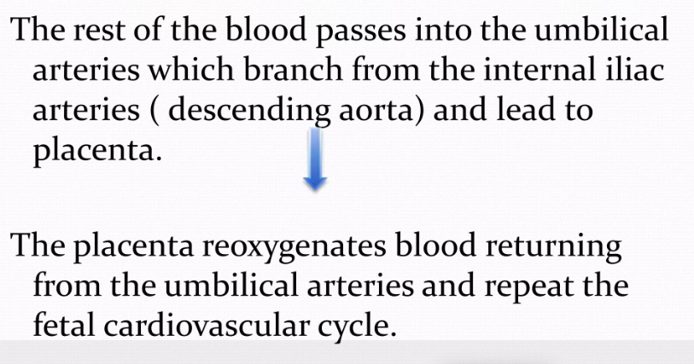

Slide 14
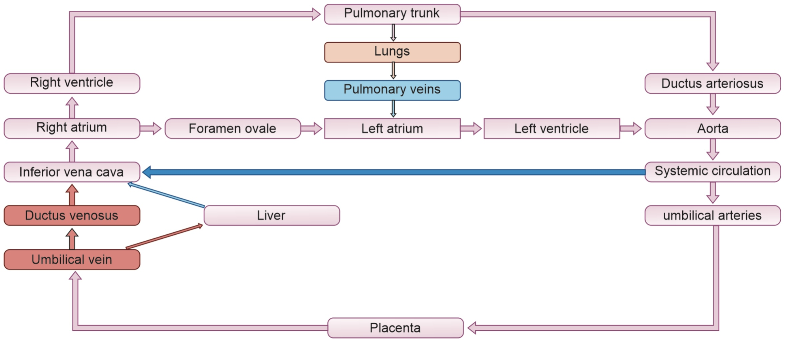
Scheme of fetal circulation

Slide 15
CHANGES OF THE FETAL CIRCULATION AT BIRTH
The following changes occur at birth
Closure of the umbilical arteries: The arteries are functionally closed after a few minutes of birth but the complete obliteration of the lumen takes 2-3 months. They got filled with connective tissue and the distal portions of the umbilical arteries become fibrous cords called the medial umbilical ligaments.
Closure of the umbilical vein: The umbilical vein collapses but remains as ligamentum teres, a structure that attaches the umbilicus to the liver.

Slide 16
Closure of the ductus venosus: It is turned into a fibrous cord present on the inferior surface of the liver called ligamentum venous .
Closure of the ductus arteriosus: It is closed as soon as the pulmonary circulation activates. It will take about 1-3 months for its complete anatomical closure and become ligamentum arteriosum.

Slide 17
Closure of foramen ovale: It can only close by an increased pressure of the left atrium combined with a decreased pressure on the right atrium. Functional closure of the foramen ovale occurs soon after birth to form a depression in the interatrial septum known as fossa ovalis. It takes about 1 year to anatomically close the ovale.

Slide 18


