Slide 1
DRUGS USED IN THE TREATMENT OF URINARY SYSTEM DISORDERS
Mrs. Shireen singh
Assistant professor

Slide 2
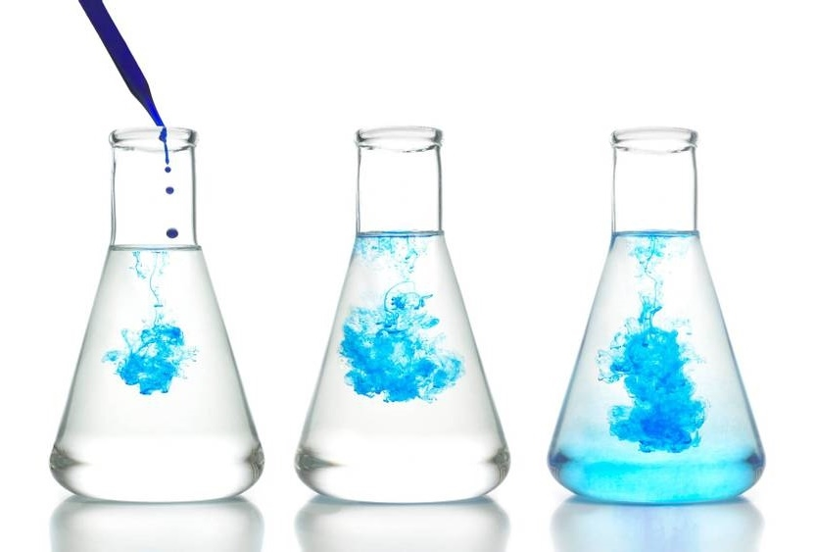
Functions of kidney
Filters the blood and help in formation of urine.
Maintain water- electrolyte balance (acid-base balance).
Production and secretion of erythropoietin (hormone help in RBC production) and renin (enzyme that regulate BP).

Slide 3

RAAS
(Renin- Angiotensin-Aldosterone System)

Slide 4
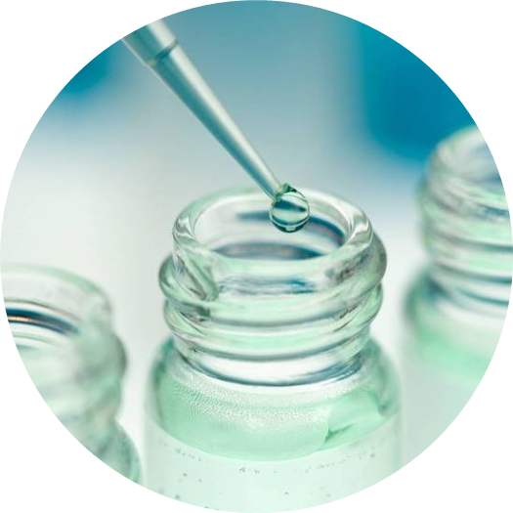
RAAS
RAAS regulate the blood pressure.
Renin helps to increase the blood pressure
Due to any reason. If there is hypovolemia, hypotension, hyponatremia and Hyperkalaemia then it reduces the blood supply to kidney, liver and lungs.

Slide 5
RAAS
When there is reduces in blood supply to kidney releases a local hormone- Renin.
When there is reduces blood supply to liver releases a hormone- Angiotensinogen.
And when there is reduced blood supply in lungs it secretes an enzyme Angiotensin converting enzyme (ACE).

Slide 6
RAAS
Angiotensinogen secreted by liver converted into Angiotensin- I done by Renin.
Angiotensin- I converts into Angiotensin- II and the converting is ACE.
Angiotensin- II act on two places- Blood vessels and adrenal gland.

Slide 7
RAAS
Angiotensin- II act on two places- Blood vessels causes vasoconstriction which increases blood pressure.
Adrenal gland makes an hormone Aldosterone- it retain sodium and water and excrete out Potassium.
This mechanism is known as RAAS mechanism.

Slide 8
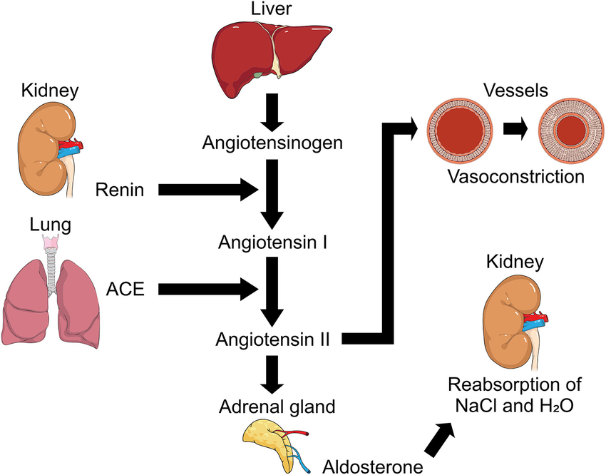
RAAS

Slide 9
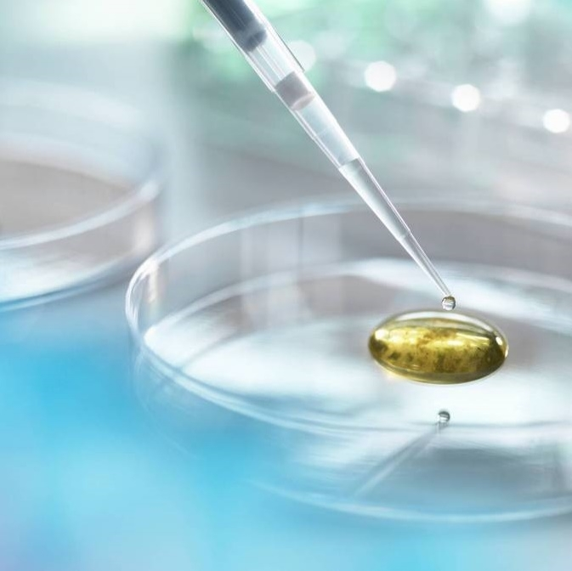
Thank you

